Slide 1
EU-Hardwoods
WP4 – Glulam made of hardwoods or mixing hardwoods and softwoods
Program update
Guillaume Legrand – FCBA, June 2016 guillaume.legrand@fcba.fr

Slide 2
WP architecture
Tasks | Milestones | Leader | Partners
WP4 Glulam made of hardwoods or mixing hardwoods and softwoods 4.1: Survey / analysis of existing data 4.2: Simulation of glued laminated hardwood timber 4.3: Production & testing of glued laminated hardwood timber 4.4: Input of experimental data to fit the model, FE calculations | 13,14 | FCBA | HFA MPA Uni LJ Simonin

Slide 3
Expected outcomes
Glulam strength model  CEN TC124/WG3 harmonized standard for glulam made of hardwoods
Economicaly and technicaly competitive glulam beam build-ups

Slide 4
Task 4.1. Survey / analysis of existing data
  January – June 2015
    Creation of a template by FCBA to collect data
    Feeding of the template by MPA (oak) and FCBA (oak, chestnut)
Origin of data | Specie | Origin specie / GLT production | Config. | Nb of tests | Lamination thickness (mm) | Lamellae strength grade | Finger joints profile l/p/bt | Beams strength grade
MPA | European Oak | France / Spain | 6 | 60 in bending 30 in compression 15 in tensile | 20 | LS13 (outer) LS10 # D 30 (inner) with add. requirements | 10/3,8/ns
MPA | European Oak | Czech Republic / Germany | 6 | 123 in bending 30 in compression | 20-23 | LS13 | 10/3,8/ns
FCBA | European Oak | France / France | 4 | 37 in bending | 21 | D30 ( + QF2) outer D30 (+ QF4) inner | 20/6,2/1 | GLh30
FCBA | Chestnut | France / France | 2 | 41 in bending 15 in 3 point bending | 22 | C24 | 15/3,8/0,42 | GLh24
To update

Slide 5
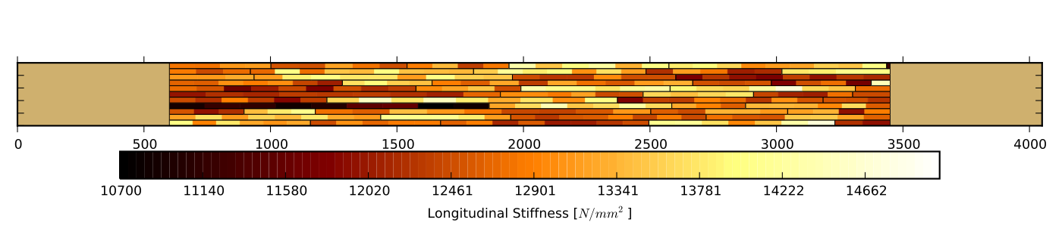
Task 4.2. Simulation of glued laminated hardwood timber
  January 2015 – September 2016
    Development of a stochastic model to predict the mechanical characteristics of glulam based on the properties of massive laminations and finger joints

Slide 6
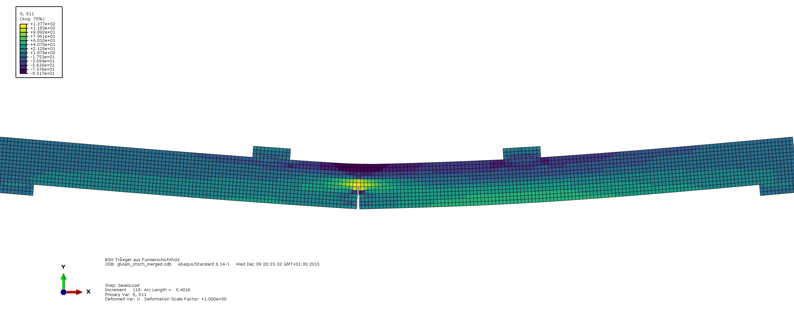
Task 4.2. Simulation of glued laminated hardwood timber
  January 2015 – September 2016
    Crack propagation is included as part of the model, to accurately represent the failure of glulam specimens (stochastically generated)

Slide 7
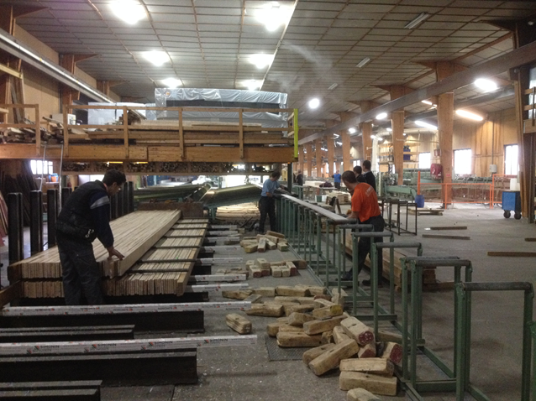
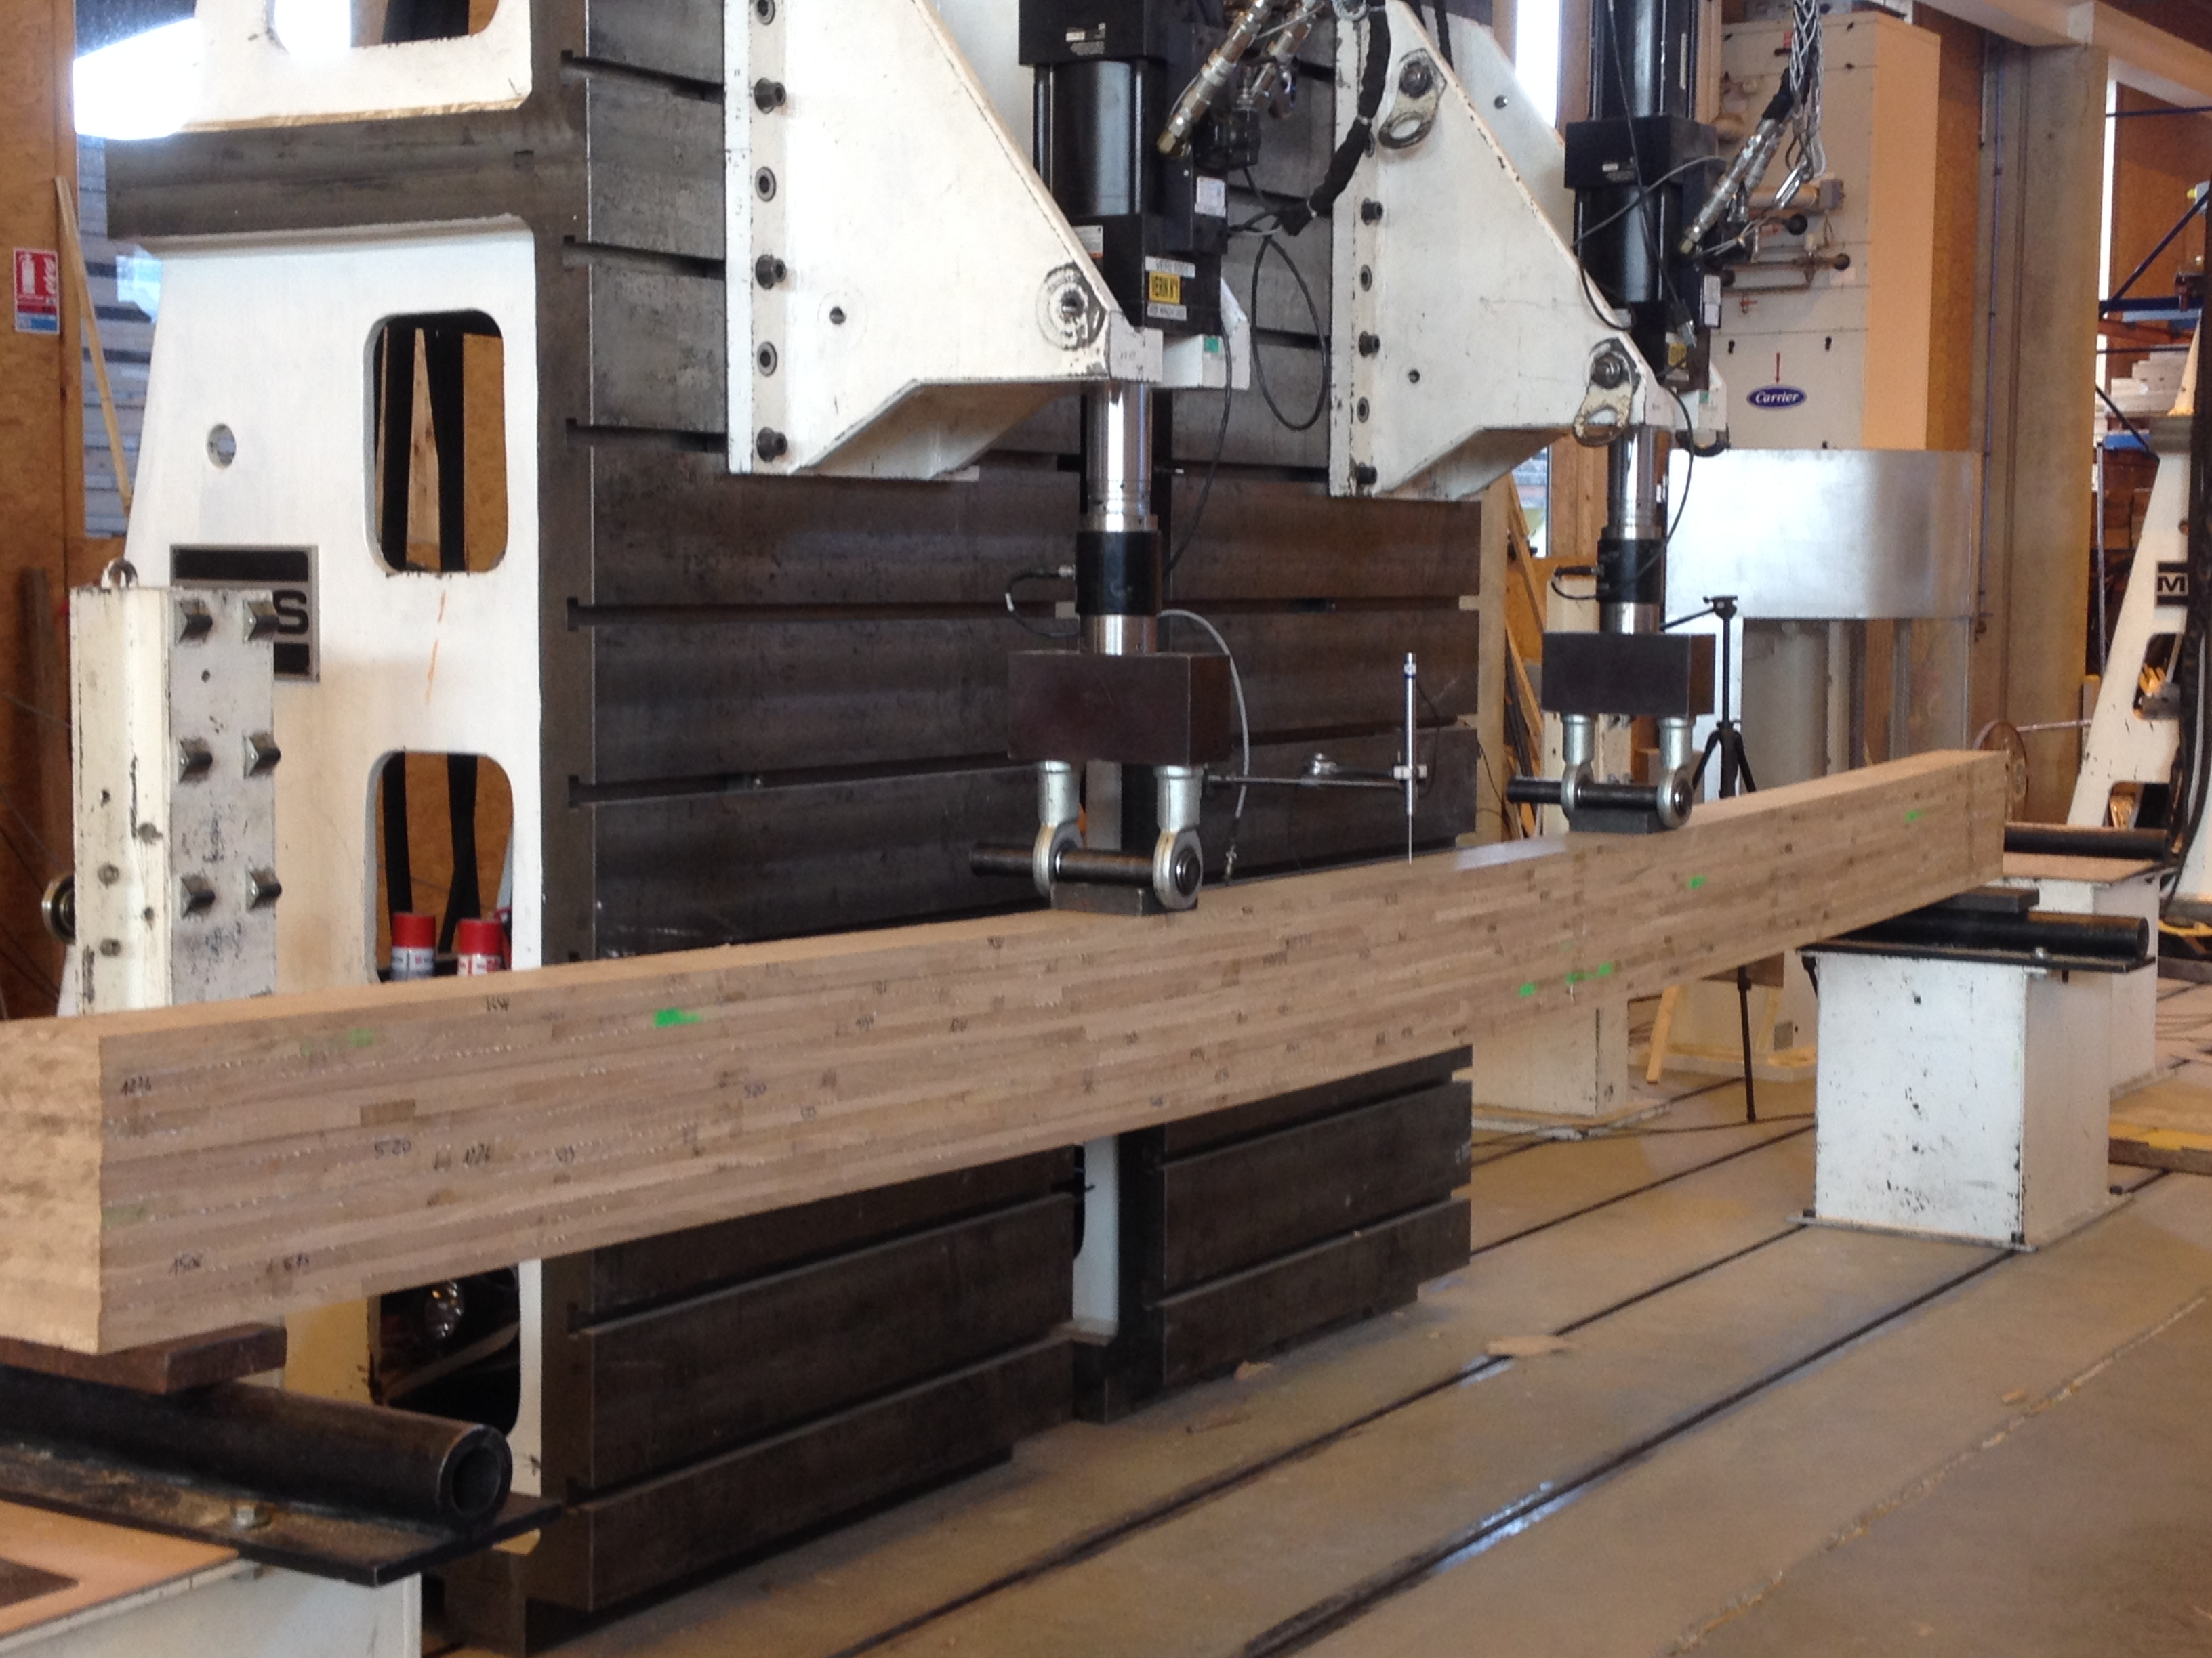
Task 4.3. Production & testing of glued laminated hardwood timber
  October 2015 – February 2016
    First prototype production at SIMONIN and testing at FCBA
    Homogeneous glulam from D24 oak laminations
Species : French Oak
Strength grade : D24
Composition : homogeneous
Sawings : 27 x 160 x 2000 mm → laminations : 20 mm
Beams :
150 x 160 x 4500 mm x 20
300 x 160 x 7000 mm x 20
Testing at FCBA according to EN 14080 (2013)
Massive laminations : flat wise 4 points bending test
Finger jointed laminations : flat wise 4 points bending test
Beams :
Flat wise 4 points bending test and compression test
Bonding quality : delamination test and shear test

Slide 8
Task 4.3. Production & testing of glued laminated hardwood timber
  October 2015 – February 2016
    First prototype production at SIMONIN and testing at FCBA
    Homogeneous glulam from D24 oak laminations
    Grading of massive laminations acc. NF B 51002, Class 2
    E dyn (MTG)
    Density
      Selection of boards with homogeneous characteristics comparable to those of the batch from which they arise  beams
      See Access data base, march 2016, for detailed results
      See Excel template, may 2016, for synthesis results
      For D24 grade acc. EN 338 :
      E_{0,mean} = 10 000 N/mm²
      f_{m,k} = 24 N/mm²
      ρ_{k} = 485 kg/m³

Slide 9
Task 4.3. Production & testing of glued laminated hardwood timber
  October 2015 – February 2016
    First prototype production at SIMONIN and testing at FCBA
    Homogeneous glulam from D24 oak laminations
    Bending tests on massive laminations acc. EN 14080 annex E :
      See Access data base, march 2016, for detailed results
      See Excel template, may 2016, for synthesis results
      E_{0,mean} = 11 600 N/mm²
      f_{m,k} = 33,3 * N/mm²
      ρ_{k} = 587 kg/m³
      * Overestimated (tested in flatwise bending,
      not on the critical defect)

Slide 10
Task 4.3. Production & testing of glued laminated hardwood timber
  October 2015 – February 2016
    First prototype production at SIMONIN and testing at FCBA
    Homogeneous glulam from D24 oak laminations
    Bending tests on beams acc. EN 14080 annex E :
      See Access data base, march 2016, for detailed results
      See Excel template, may 2016, for synthesis results
      E_{0,g,mean} = 11 900 11 400 N/mm²
      f_{m,g,k} = 28,4 29,1 N/mm²
      ρ_{g,k} = 624 628 kg/m³

Slide 11
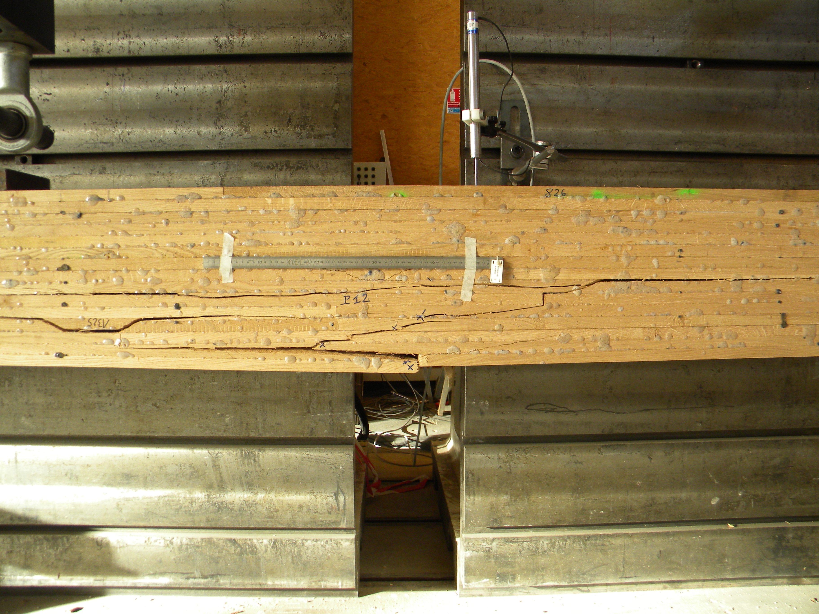
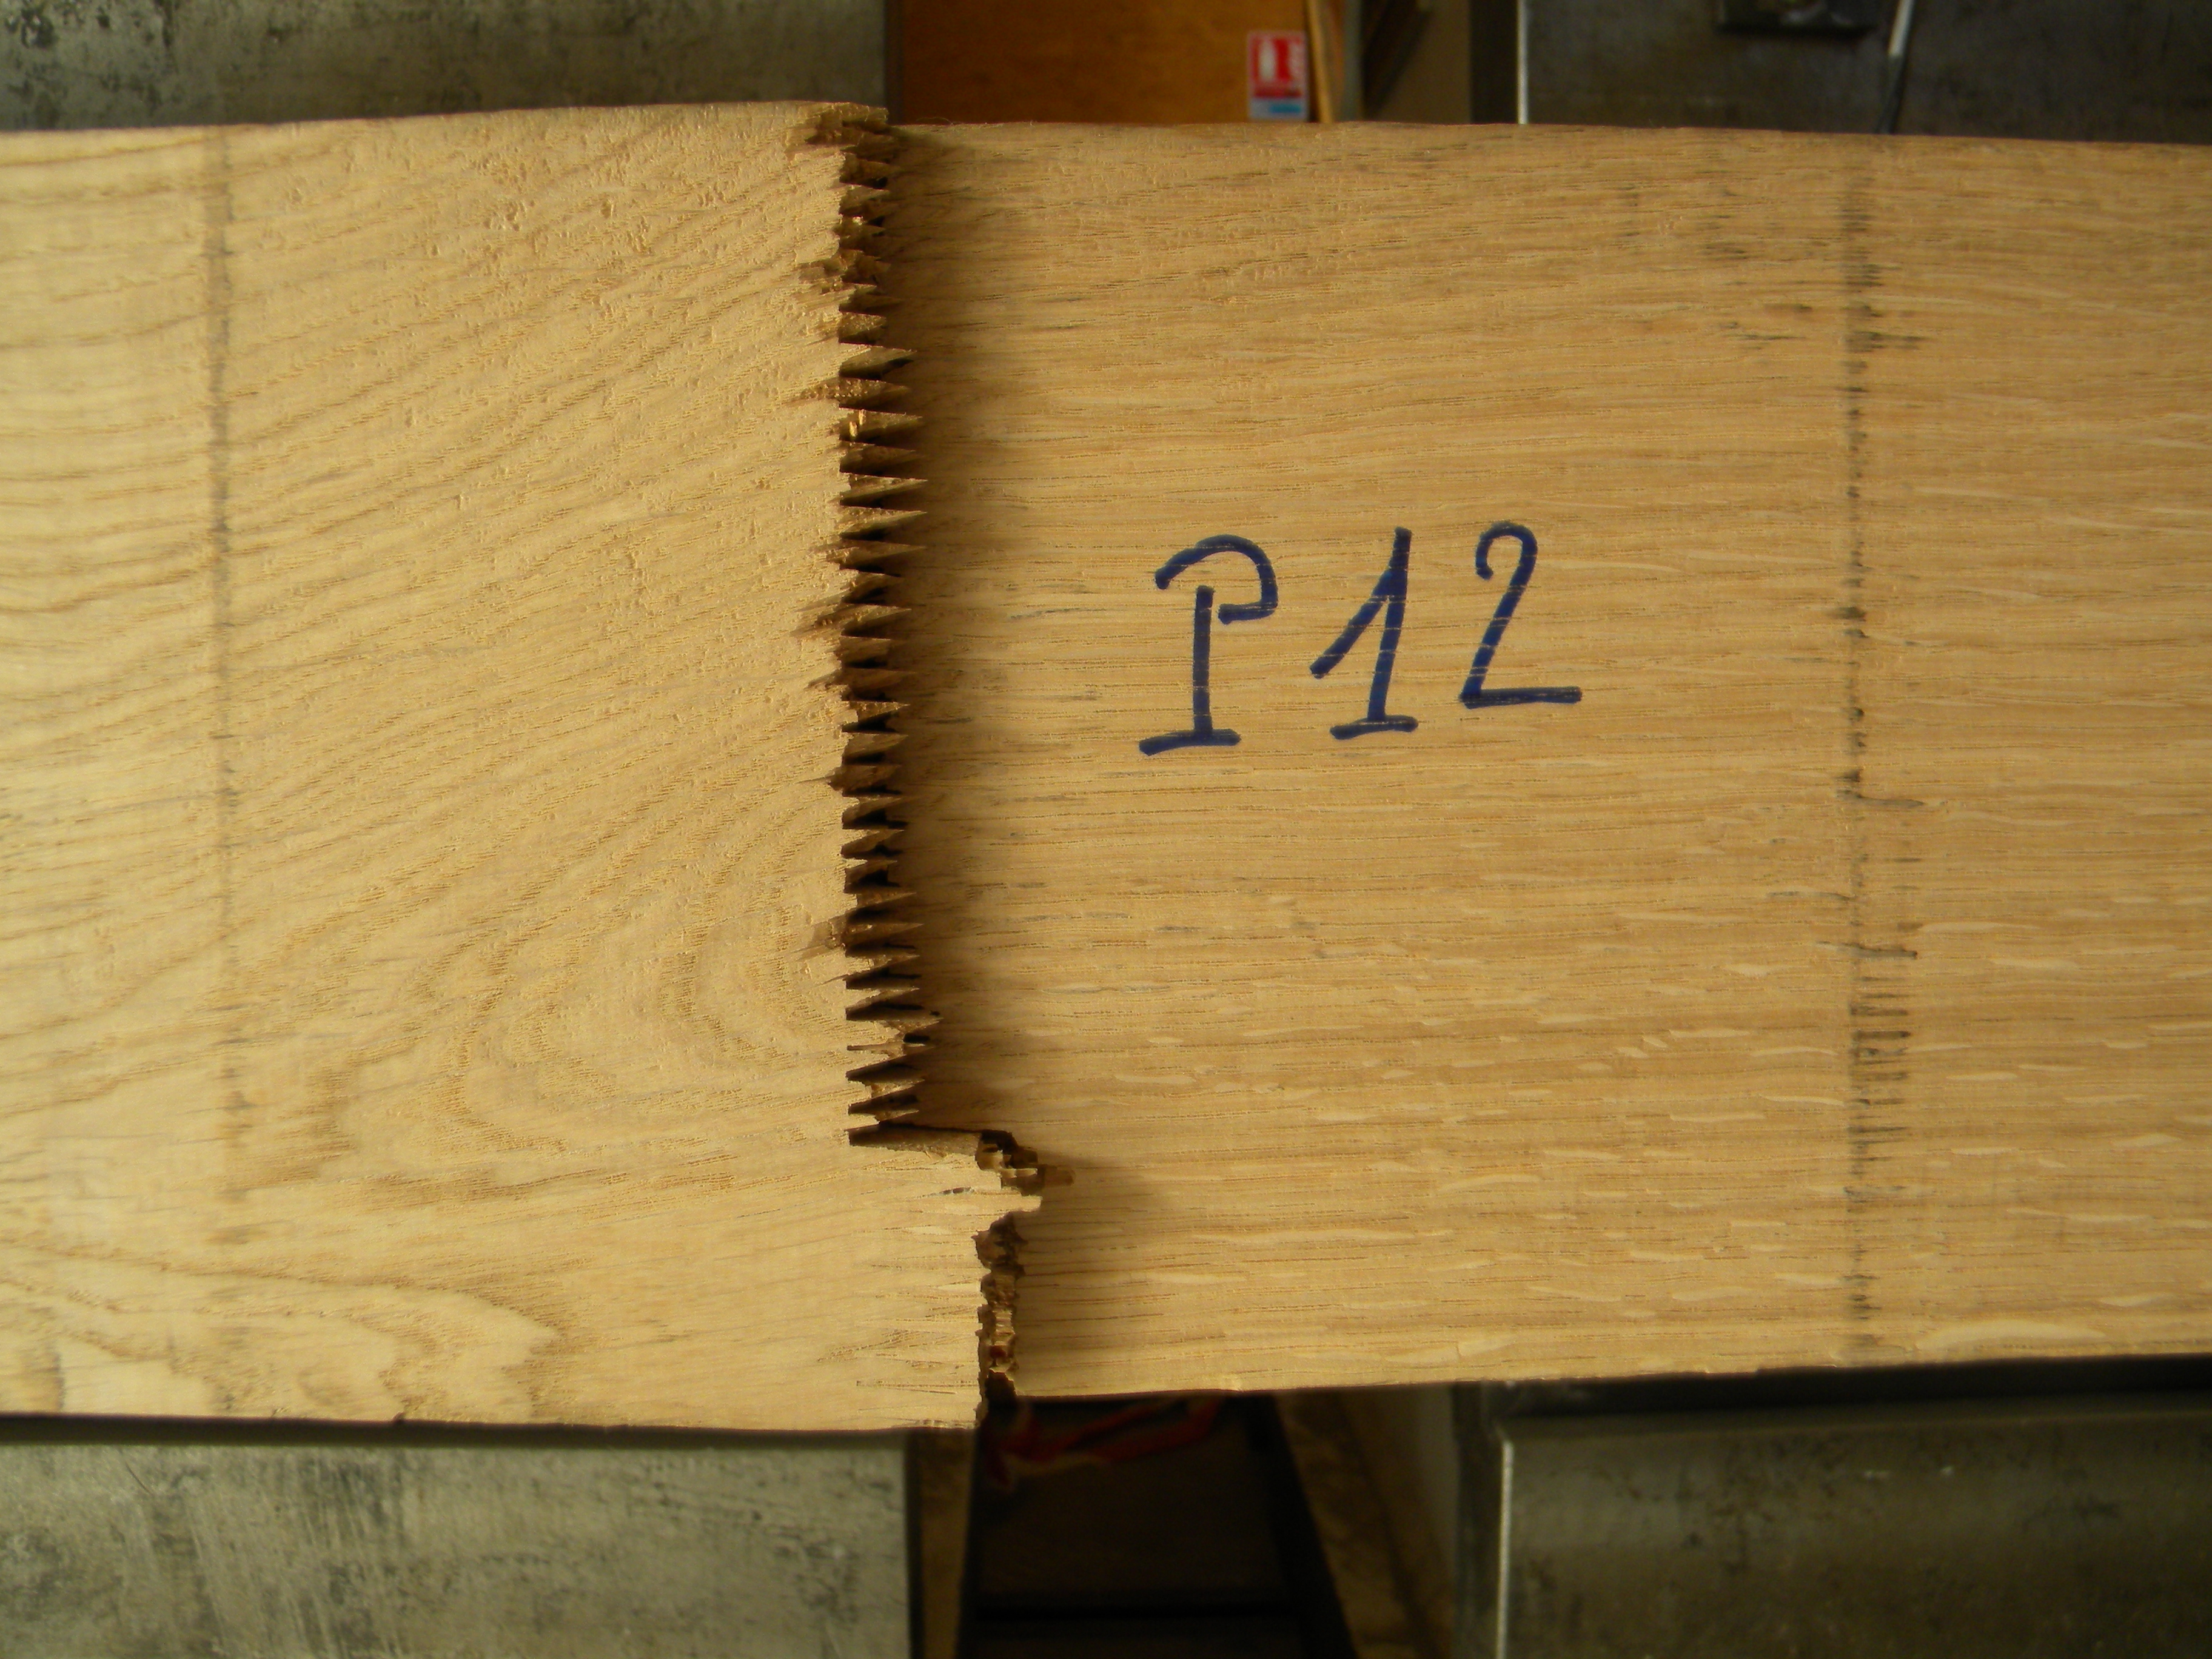
Task 4.3. Production & testing of glued laminated hardwood timber
  October 2015 – February 2016
    First prototype production at SIMONIN and testing at FCBA
    Homogeneous glulam from D24 oak laminations
    Bending tests on beams acc. EN 14080 annex E :
      Mode of failure

Slide 12
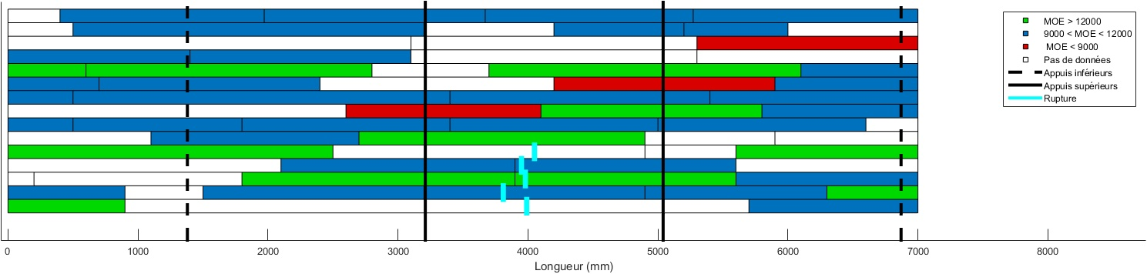
Task 4.3. Production & testing of glued laminated hardwood timber
  October 2015 – February 2016
    First prototype production at SIMONIN and testing at FCBA
    Homogeneous glulam from D24 oak laminations
    Bending tests on beams acc. EN 14080 annex E :
      Crack propagation

Slide 13
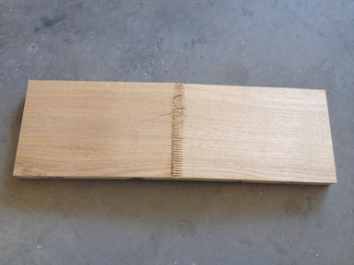
Task 4.3. Production & testing of glued laminated hardwood timber
  October 2015 – February 2016
    First prototype production at SIMONIN and testing at FCBA
    Homogeneous glulam from D24 oak laminations
    Bending tests on finger jointed laminations acc. EN 14080 annex E
      See Access data base, march 2016, for detailed results
      See Excel template, may 2016, for synthesis results
      f_{m,j,k} = 30,1 N/mm²
      Mode of failure : A2 and A3

Slide 14
Task 4.3. Production & testing of glued laminated hardwood timber
  October 2015 – February 2016
    First prototype production at SIMONIN and testing at FCBA
    Homogeneous glulam from D24 oak laminations
    Delamination tests on full glue laminated beams cross section acc. EN 14080, annex C, method B

Slide 15
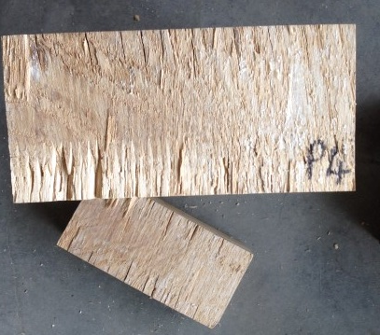
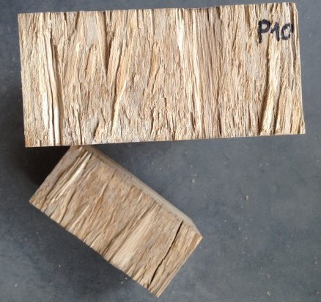
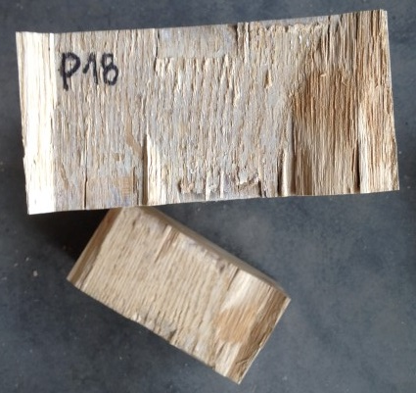
Task 4.3. Production & testing of glued laminated hardwood timber
  October 2015 – February 2016
    First prototype production at SIMONIN and testing at FCBA
    Homogeneous glulam from D24 oak laminations
    Delamination tests on full glue laminated beams cross section acc. EN 14080, annex C, method B

Slide 16
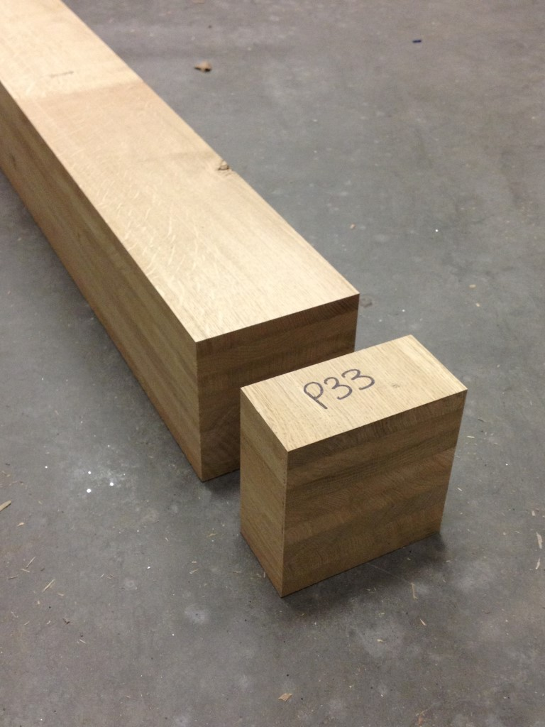
Task 4.3. Production & testing of glued laminated hardwood timber
  October 2015 – February 2016
    First prototype production at SIMONIN and testing at FCBA
    Homogeneous glulam from D24 oak laminations
    Delamination tests on full glue laminated beams cross section acc. EN 14080, annex C, method B

Slide 17
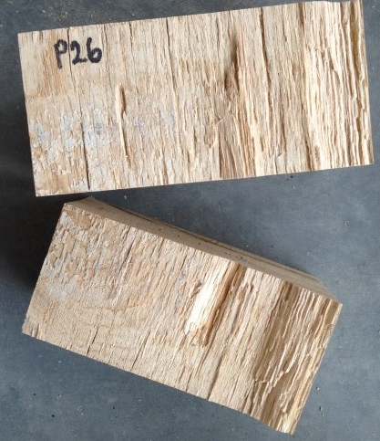
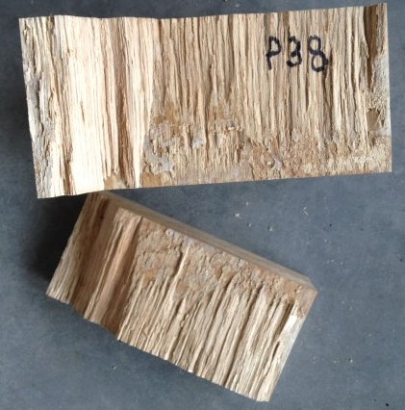
Task 4.3. Production & testing of glued laminated hardwood timber
  October 2015 – February 2016
    First prototype production at SIMONIN and testing at FCBA
    Homogeneous glulam from D24 oak laminations
    Delamination tests on full glue laminated beams cross section acc. EN 14080, annex C, method B

Slide 18
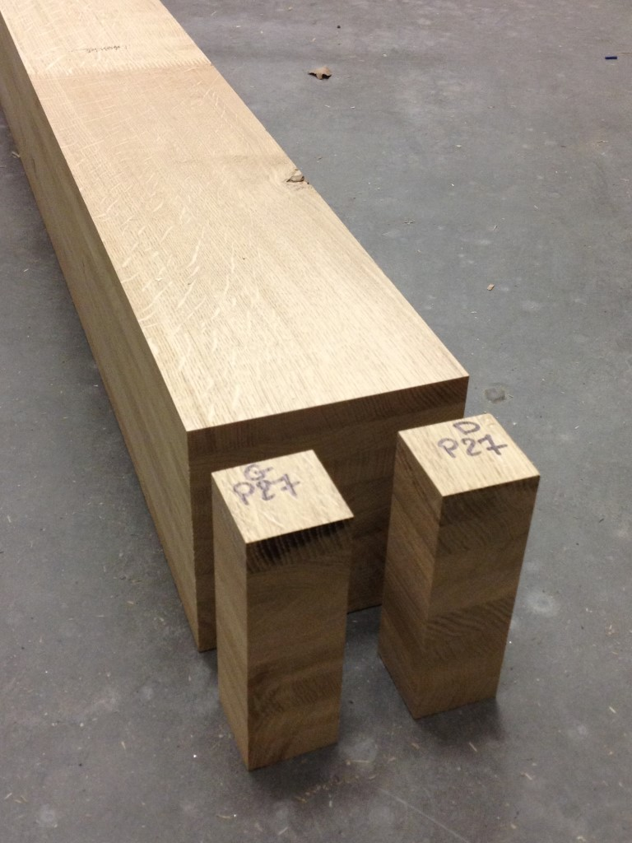
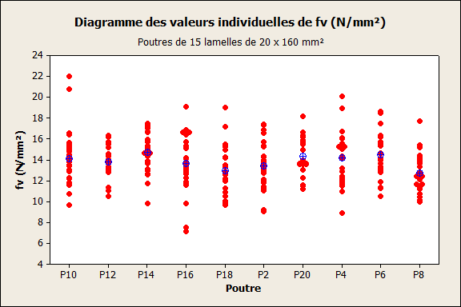
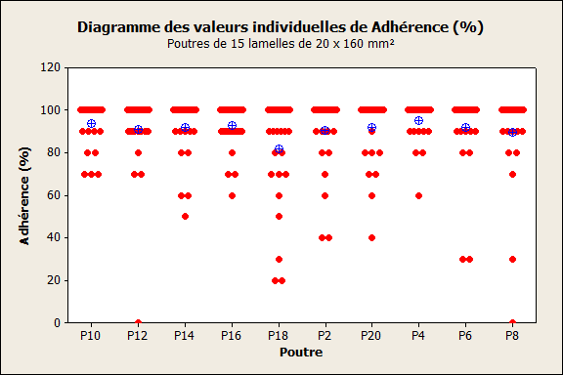
Task 4.3. Production & testing of glued laminated hardwood timber
  October 2015 – February 2016
    First prototype production at SIMONIN and testing at FCBA
    Homogeneous glulam from D24 oak laminations
    Shear tests on full glue laminated beams cross section acc. EN 14080, annex D

Slide 19
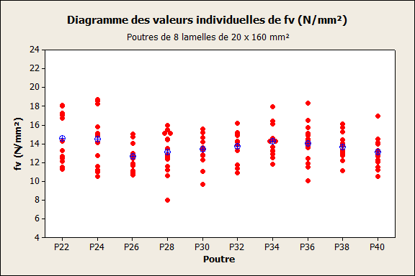
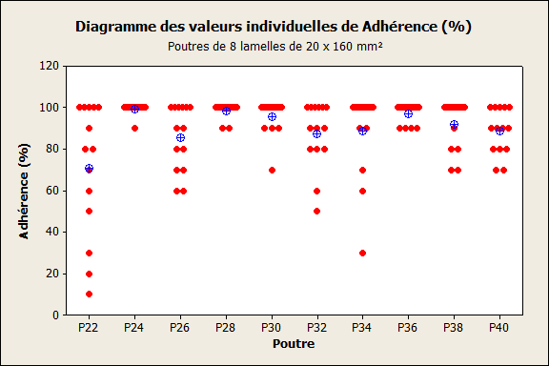
Task 4.3. Production & testing of glued laminated hardwood timber
  October 2015 – February 2016
    First prototype production at SIMONIN and testing at FCBA
    Homogeneous glulam from D24 oak laminations
    Shear tests on full glue laminated beams cross section acc. EN 14080, annex D

Slide 20
Task 4.3. Production & testing of glued laminated hardwood timber
  January 2016 – August 2016
    Second prototype production at SIMONIN and testing at FCBA :
      Sampling, drying and sawing of mid size/age oak
      Grading
      Production of inhomogeneous glulam beams :
        D18/D30
        D24/D30
        D24/D40
    Testing at FCBA :
        Massive laminations :
          Flat wise 4 points bending test x 40
          Tensile test x 40
        Finger jointed laminations :
          Flat wise 4 points bending test x 40
          Tensile test x 40
        Beams
          Flat wise 4 points bending test x 20
          Bonding quality : delamination and shear tests x 10

Slide 21
Task 4.3. Production & testing of glued laminated hardwood timber
  Input from other projects : June 2016
    National study for the use of french beech in construction
      Sampling, drying and sawing
      Grading
      Production of homogeneous glulam beams :
        D35
        D45
    Testing at FCBA :
        Massive laminations :
          Flat wise 4 points bending test x 40
          Tensile test x 40
        Finger jointed laminations :
          Flat wise 4 points bending test x 40
          Tensile test x 40
        Beams
          Flat wise 4 points bending test x 20
          Compression test (longitudinal + transverse) x 20
          Bonding quality : delamination and shear tests x 10

Slide 22
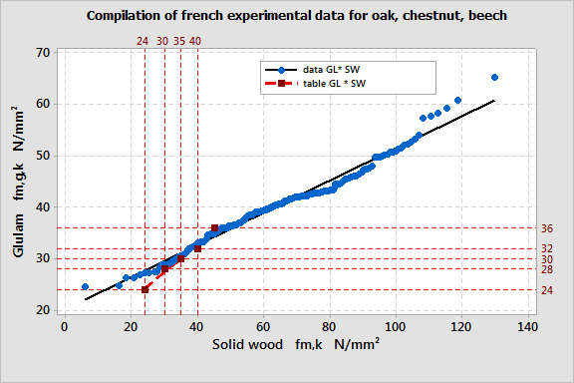
Task 4.4 Input of experimental data to fit the model, FE calculations
    November 2015 – September 2016
    WP2 + WP3 + WP4 :
    Glulam strength model, proposal for table GL / SW
    → CEN TC124/WG3 harmonized standard for glulam made of hardwoods

Slide 23
Task 4.4 Input of experimental data to fit the model, FE calculations
    November 2015 – September 2016
    WP2 + WP3 + WP4 :
    Glulam strength model, proposal for correlation table GL / SW
    → CEN TC124/WG3 harmonized standard for glulam made of hardwoods

Slide 24
Task 4.4 Input of experimental data to fit the model, FE calculations
    November 2015 – September 2016
    WP1 + WP4 :
    Economicaly and technicaly competitive glulam beam build-ups

Slide 25
Looking forward to presenting the whole results at final dissemination event!
Jean Denis Lanvin (jean-denis.lanvin@fcba.fr)
Didier Reuling (didier.reuling@fcba.fr)
Carole Faye (carole.faye@fcba.fr)
Guillaume Legrand (guillaume.legrand@fcba.fr)

